Slide 1





Digital Marketing
Strategy
Your Business Name Here
(pick a local business or present your own business idea)

Slide 2

Talk Agency
Welcome
Digital Marketing Strategy Overview
Our digital marketing strategy is designed to position your small business for online success. It focuses on creating a robust online presence through social media, SEO optimisation, and compelling content marketing. By leveraging data-driven insights and innovative digital tools, we aim to increase your brand's visibility, engage your target audience, and drive conversions. Our comprehensive approach ensures that every aspect of your digital marketing efforts works harmoniously to achieve your business objectives, making your brand not just visible but vital to your audience.
Let's dive in!

Slide 3
Talk Agency
About ‘your business name here’
Background
Include here

Slide 4
Talk Agency
About ‘your business name here’
Missions and values
(Linking to broader societal or community impact)
Include here

Slide 5
Talk Agency
Target Audience
Primary

Slide 6
Talk Agency
Primary Target Audience
Overview
About
Age:
Job Title:
Location:
Character:
Goals
  Frustrations

Slide 7
Talk Agency
Target Audience
Secondary

Slide 8
Talk Agency
Secondary Target Audience
Overview
About
Age:
Job Title:
Location:
Character:
Goals
  Frustrations

Slide 9
Talk Agency
Buyer's Journey
Now that you've identified your primary and secondary target audiences, it’s time to understand how they move from discovering your business to making a purchase.
Complete the Buyer’s Journey table (next slide) for each of your audiences. At each stage, consider:
What are they thinking or feeling?
What challenges or questions do they have?
What information do they need to move forward?
What marketing activities could support them at this stage?
Complete your Buyers Journey Here

Slide 10
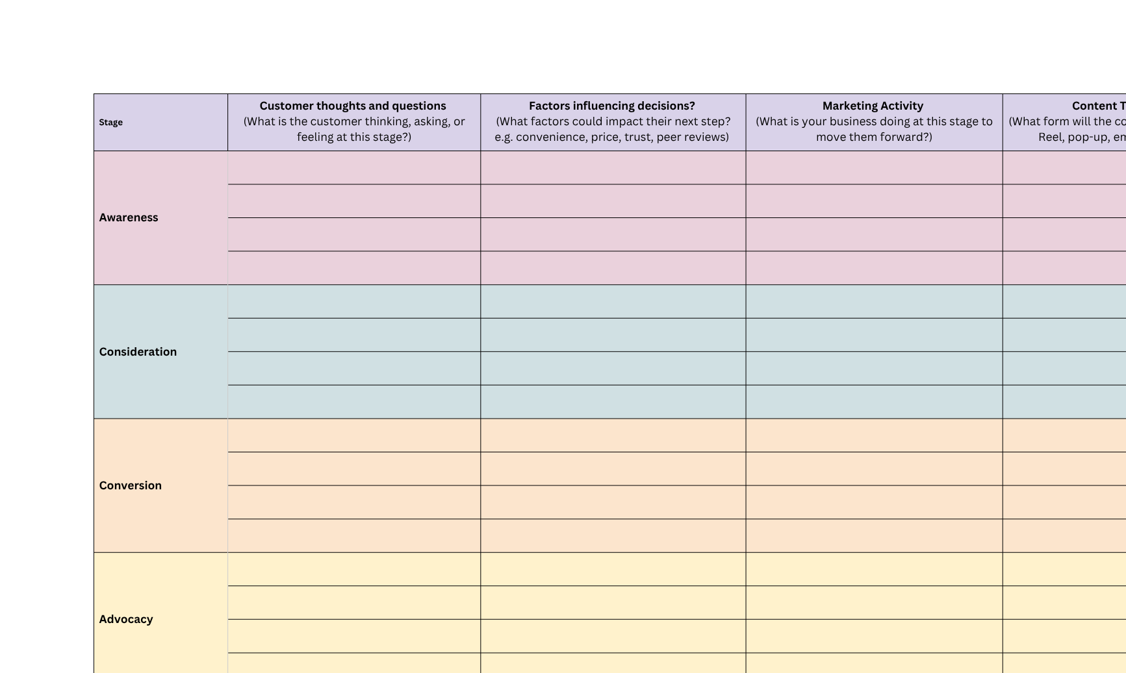
(Alternatively access spreadsheet or Google Drive Sheet to complete - seek links from your teacher).
Buyers Journey

Slide 11
Talk Agency
Unique Selling Proposition (USP)

Slide 12
Talk Agency
Unique Selling Proposition: Example
A Unique Selling Proposition (USP) refers to the distinct benefit or advantage that makes a company's product or service different and better than that of its competitors. It's what sets a business apart in the marketplace and is often the reason consumers choose one brand over another. A strong USP clearly articulates why a product or service is the best solution for the customer's needs, focusing on unique qualities or value that competitors do not offer.
  List Your Features and Benefits:
  Feature: Handmade jewelry. Benefit: Offers a unique, personal touch not found in mass-produced items.
  Feature: Free local delivery Benefit: Saves customers time and money on shipping
  Feature: Eco-friendly packaging Benefit: Appeals to environmentally conscious customers
  Feature: All-natural ingredients (soap) Benefit: Gentle on skin and safe for sensitive users
  Identify What Makes You Different:
  Unique Aspect: Custom design consultation for every piece.
  Unique Aspect: Locally sourced materials
  Unique Aspect: Fast 2-day turnaround for custom orders
  Unique Aspect: Loyalty program for return customers
  USP: We create handmade jewelry with custom design consultations, offering one-of-a-kind pieces that reflect your personal style—something mass-produced brands simply can’t match.

Slide 13
Talk Agency
Unique Selling Proposition
List Your Features and Benefits: Write down all the features of your products/services and the benefits they provide. Remember, features are what your product is or has, while benefits are the outcomes that those features deliver to your customers.
Feature:
Benefit:
Feature:
Benefit:
Feature:
Benefit:
Feature:
Benefit:
Feature:
Benefit:

Slide 14
Talk Agency
Unique Selling Proposition
Identify What Makes You Different: Considering your list of features and benefits, highlight what you believe is not offered by your competitors or is done uniquely by you.
Unique Aspect:
Unique Aspect:
Unique Aspect:
Unique Aspect:

Slide 15
Talk Agency
Unique Selling Proposition
Refine Your USP: Based on your features, benefits and unique aspects draft a statement that captures your USP.
[Your Product/Service] helps [Target Audience] by providing [Unique Benefit or Solution] that [Why It Matters].

Slide 16
Talk Agency
Positioning Statement

Slide 17
Talk Agency
Positioning Statement
Start by identifying your target audience, the market need, how your product or service fulfills this need, and what distinguishes it from competitors. The statement should be concise, specific, and reflect your brand's essence.
"For [target audience], [Your Business Name] is the [category] that delivers [unique benefit/USP] because [reason why]. Unlike [primary competitor], [Your Business Name] offers [key differentiator]."

Slide 18
Talk Agency
Goals & Objectives

Slide 19
Talk Agency
Setting SMART Goals Example
SMART goals are specific, measurable, achievable, relevant, and time-bound objectives that guide successful planning and achievement.
GOAL: Increase Website Traffic
Specific: What exactly do you want to achieve?
Example: Increase website traffic focusing on electrical services, home building, and solar installations.
Measurable: How will you measure success?
Example: Monitor traffic via Google Analytics, track keyword rankings, and click-through rates (CTRs) from PPC ads..
Achievable: Is your goal realistic with the resources you have?
Example: Yes, by implementing a targeted SEO strategy and launching PPC campaigns, leveraging existing content and marketing budget.
Relevant: Does this goal support your broader business objectives?
Example: Yes, increased website traffic can lead to more inquiries and potential customers, contributing to revenue growth.
Time-bound: By when do you want to achieve this goal?
Example: Within the next 6 months.
Examples for Reference:
Well-Defined Goal: Increase website traffic by 25% in the next 6 months through an SEO strategy focusing on electrical services, home building, and solar installations, and launching targeted PPC campaigns.
Poorly Defined Goal: Get more visitors to the website.

Slide 20
Talk Agency
Goals & Objectives Example
What does this strategy aim to achieve in the next 12 months?
Business Goals: Increase annual revenue by 40% within the next 12 months.
Business objective | Marketing objective/tactic | How to measure
Goal One: Increase traffic by 25% in 6 months via SEO & PPC | Implement an SEO strategy focusing on electrical services, home building, and solar installations. Launch targeted PPC campaigns. | Monitor traffic via Google Analytics, track keyword rankings, and CTRs from PPC ads.
Goal Two: Generate 50 additional leads per month in 4 months using lead magnets and social media ads. | Use lead magnets like free guides or discount offers and strong CTAs on the website. Run targeted ads on social media. | Track the number of inquiries and conversion rates using Google Analytics and social media analytics.
Goal Three: Boost brand awareness and recall (Increase social media engagement by 30%, followers by 20%, and traffic from content by 15% in 5 months through posts and local collaborations.) | Publish engaging content, enhance social media activity with regular posts and customer stories, collaborate with local businesses | Measure social media engagement, follower growth, and traffic from content efforts.
Goal Four: Improve the online customer journey. (Increase conversion rates by 20% and reduce bounce rates by 15% in 3 months using heat mapping and A/B testing) | Use heat mapping for user interaction analysis, conduct A/B tests to optimise website elements. | Analyse improvements through heat mapping, monitor reduced bounce rates, and track conversion increases from A/B testing.

Slide 21
Talk Agency
Setting SMART Goals
SMART goals are specific, measurable, achievable, relevant, and time-bound objectives that guide successful planning and achievement.
GOAL:
Specific: What exactly do you want to achieve?
Specific:
Measurable: How will you measure success?
Measurable:
Achievable: Is your goal realistic with the resources you have?
Achievable:
Relevant: Does this goal support your broader business objectives?
Relevant:
Time-bound: By when do you want to achieve this goal?
Time-bound:
Business GOAL:
Well-Defined Goal: Increase website traffic by 25% in the next 6 months through an SEO strategy focusing on electrical services, home building, and solar installations, and launching targeted PPC campaigns.

Slide 22
Talk Agency
Goals & Objectives
What does this strategy aim to achieve in the next 12 months?
Business Goals:
Business objective | Marketing objective/tactic | How to measure
Goal One:
Goal Two:
Goal Three:
Goal Four:

Slide 23
Talk Agency
Marketing Calendar
Now that you’ve created your business and set your SMART goals, use this 12-month calendar to plan your marketing activities.
This will help you:
  Ensure you’re consistently marketing across channels
  Plan around product launches, seasonal trends, or key events
  Align campaigns with your goals and customer needs
  Complete Your Yearly Marketing Calendar

Slide 24
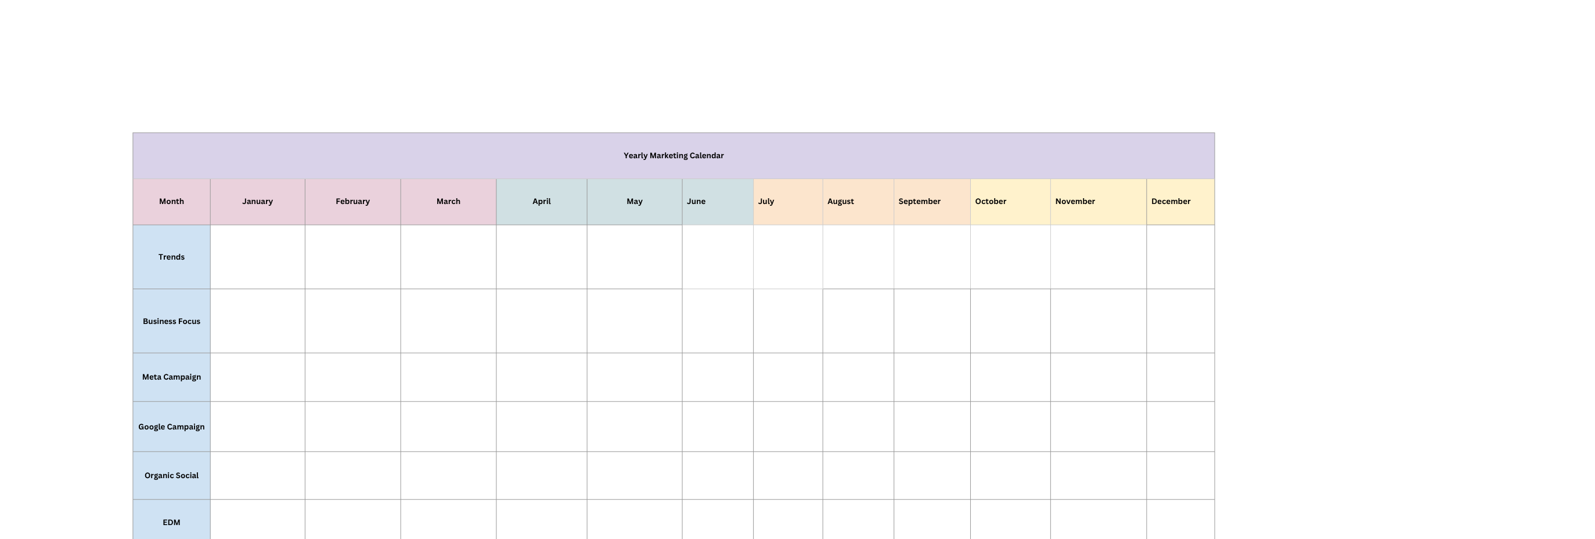
(Alternatively access spreadsheet or Google Drive Sheet to complete - seek links from your teacher).
Marketing Calendar

Slide 25
Talk Agency
Tone Of Voice

Slide 26
Talk Agency
TOV
Identifying the tone of voice for your brand involves understanding the personality you want your brand to convey and how it speaks to your audience. This tone should be consistent across all communication channels and content, reflecting your brand's values, audience's preferences, and the context of your message.
To help identify your tone of voice, highlight green 5 words that align with your brand and highlight red 3 words that do not.
Authoritative | Passionate | Caring/Warm | Playful | Conversational | Romantic | Sympathetic
Coarse | Quirky | Conservative | Respectful | Formal | Upbeat | Humorous
Empathetic | Serious | Enthusiastic | Adventure | Funny | Unapologetic | Nostalgic/ Experienced
Friendly | Trendy | Fun/ Respectful | Trustworthy/ Genuine | Matter-of-fact | Professional /Relaxed | Freedom
Informative/ Knowledgeable | Witty | Irreverent | Cheerful | Professional | Dry | Sarcastic

Slide 27
Talk Agency
TOV
Identifying the tone of voice for your brand involves understanding the personality you want your brand to convey and how it speaks to your audience. This tone should be consistent across all communication channels and content, reflecting your brand's values, audience's preferences, and the context of your message.
Think about how these traits you identify above and how these can translate into your communication. For instance, if you're 'compassionate,' your messages might be more empathetic and supportive. Jot down some phrases or sentences as examples.

Slide 28
Talk Agency
Distributing Our Voice

Slide 29
Talk Agency
Content Pillars
Content pillars are thematic cornerstones for your content strategy, each representing a main topic relevant to your audience. They organise and guide the creation of subtopics and individual content pieces (like blog posts, videos) to ensure consistency, relevance, and support for SEO and brand authority across all marketing efforts.
Awareness
Pillar One -
Consideration
Pillar Two -
Conversion
Pillar Three -
Loyalty
Pillar Four -

Slide 30

Talk Agency
Thank you

